Slide 1
You have to do it that way because all of your classmates do it that way.
Either you’re with us or against us.
Humans cannot be replaced by AI because humans are irreplaceable.
God exists because the Bible says so, and the Bible is the word of God.
All of my friends slept through ENG1002, and they all passed. There’s no reason why it won’t be the same for me.
You can’t trust Tom’s opinion on climate change because he’s not a scientist.
If America can be the first country to put a person on the moon, it can also be the first country to put a person on Mars.

Slide 2
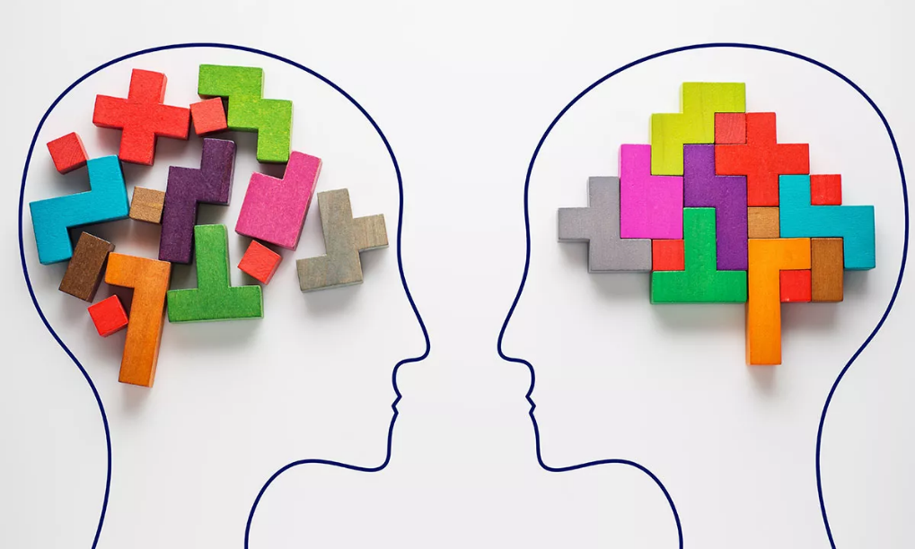
Avoiding Logical Fallacies
Module III Research Steps

Slide 3
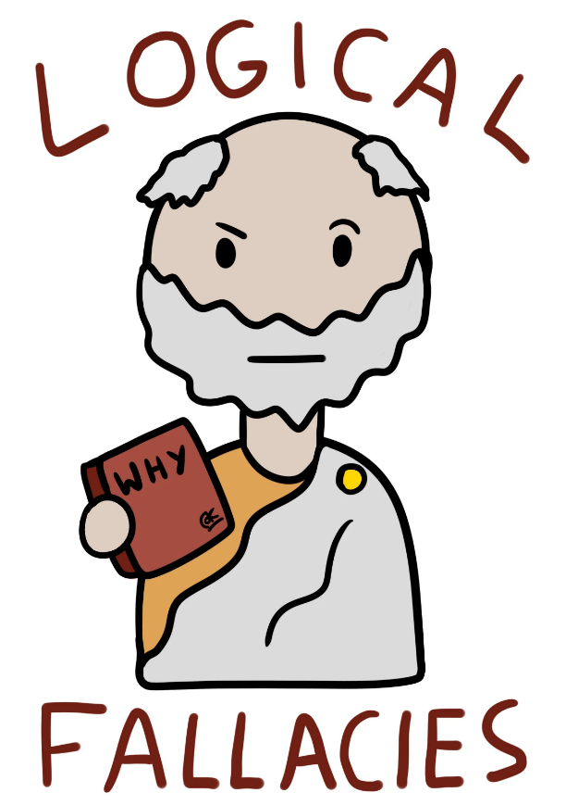
What is a logical fallacy?
A logical fallacy is an error in reasoning that can undermine the logic of your argument.
Fallacies can be either illegitimate arguments or irrelevant points that cannot support your claim.
Notes:
https://owl.purdue.edu/owl/general_writing/academic_writing/logic_in_argumentative_writing/fallacies.html

Slide 4
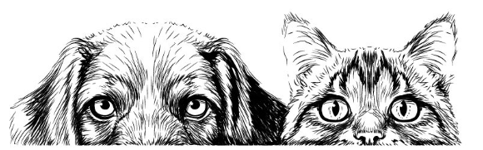
Logical Fallacies
1. Hasty Generalization | 8. Genetic Fallacy
2. Stereotypes | 9. Appeal to Ignorance
3. Fallacy of Composition | 10. Circular Argument
4. False Analogy | 11. Red Herring
5. Slippery Slope | 12. Straw Man
6. Either/or Fallacy | 13. False Cause
7. Ad Hominem | 14. The Ad Populum Fallacy

Slide 5

1. Hasty Generalization
Hasty generalization refers to a conclusion based on insufficient or unrepresentative evidence.
e.g.,
That taxi driver tried to cheat me. All taxi drivers are dishonest.
I went to a Sichuan restaurant in Shenzhen, and the food was terrible. All Sichuan restaurants in Shenzhen must have bad food.
Drawing conclusions based on a single bad experience can be unreliable due to the small sample size.

Slide 6
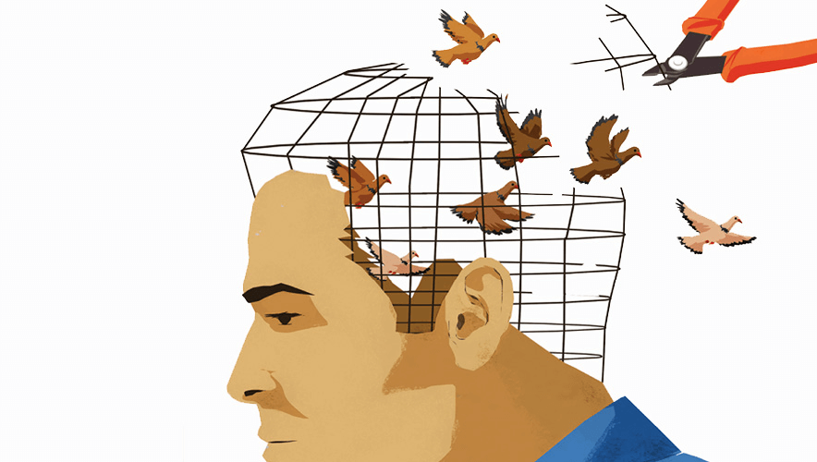
2. Stereotypes
A stereotype is a hasty generalization about a group.
A stereotype is an oversimplified and generalized belief about a group of people based on incomplete or inaccurate information
e.g.,
Women are bad bosses.
Politicians are corrupt.
Children are always curious.

Slide 7
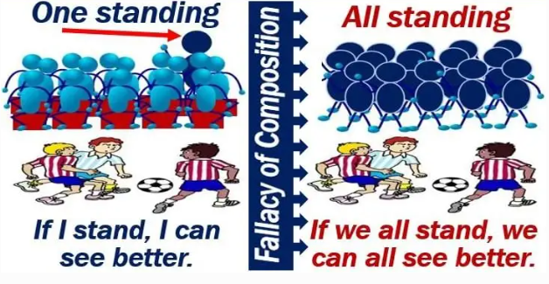
3. Fallacy of Composition
It is assumed that what is true for one part of a system or group is true for the whole system or group.

Slide 8

3. Fallacy of Composition
e.g., Every part of this machine is light in weight; therefore this machine as a whole must be light too.
This fallacy takes the following logical form:
Y is part of X.
Y has property A.
Therefore, X has property A.

Slide 9

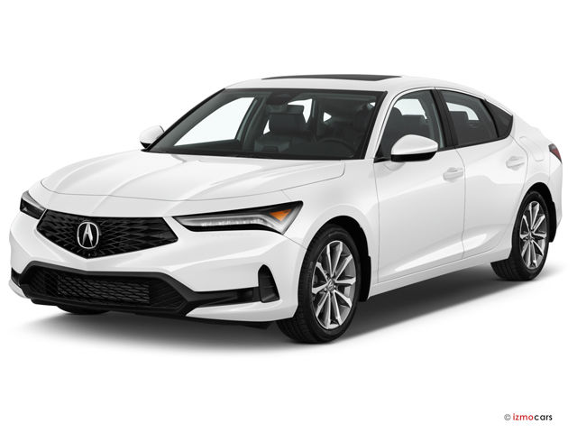
4. False Analogy
This fallacy compares two things that are not actually similar, in order to make a point about one of them.
e.g., Cars cause many more deaths than firearms do, so if we are going to ban firearms, we should also ban cars.

Slide 10


How are these ideas related?
e.g., If we can find a cure for the common cold, we should be able to send a spacecraft to Mars.
Exploring the solar system
VS.
Finding a cure for the common cold

Slide 11
Some more examples
Scenario 1: Every year more people die in car crashes than in plane crashes. You will be much safer if a plane crashes.
Scenario 2: Reading makes you smarter, that’s why it’s always a good idea to read the labels on products you buy.
Scenario 3: Jane really wants a best friend but she is home schooled and finds it hard to make friends. Her father says she should just get a dog because they are a human’s best friend.

Slide 12

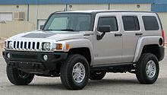
5. Slippery Slope
This is a conclusion based on the premise that if A happens, then eventually through a series of small steps, through B, C,..., X, Y, Z will happen, too, basically equating A and Z.
So, if we don't want Z to occur, A must not be allowed to occur either.
e.g., If we ban Hummers because they are bad for the environment eventually the government will ban all cars, so we should not ban Hummers.

Slide 13


Slide 14


6. Either/or Fallacy (False Dilemma)
The either/or argument is a conclusion that oversimplifies the problem by reducing it to only two choices, but in reality there may be other alternatives.
e.g., We either ban cars or destroy the earth.

Slide 15
In writing and debates…
When reasoning about problems and solutions, writers need to weigh different options and mention a range of different options, showing why one is superior to the others or might work well in combination with others.

Slide 16

7. Ad Hominem
An ad hominem argument is an attack on the character of a person rather than a response to his or her opinions or arguments.

Slide 17
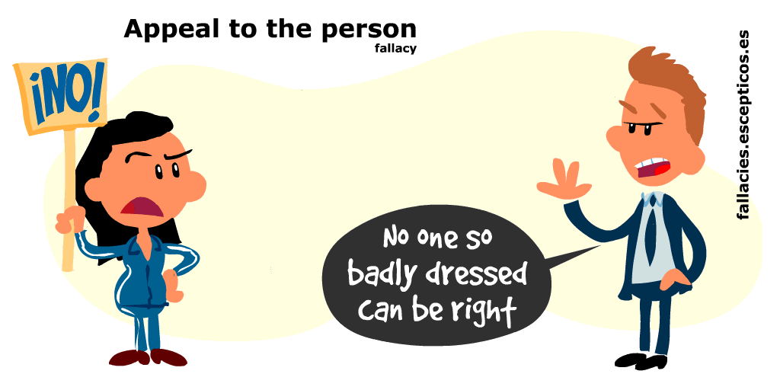
Some more examples
1. You have no idea what you’re talking about; you’ve only lived here for six months.
2. It’s hard to take your claims seriously because you spend your days playing video games.
3. You don’t understand this proposal because you don’t have a PhD degree.

Slide 18
Compare these two arguments:
“You’re too dumb to understand the issue.”
“You’re wrong because you’re too dumb to understand the issue.”
Which one is ‘ad hominem argument’?
Now consider this argument:
“You’re wrong because recent data show that the issue is multifaceted and thus cannot be solved through a simple budget increase. You’re dumb for using simplistic thinking.

Slide 19
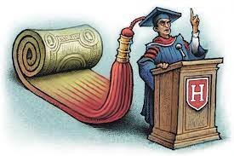
8. Genetic Fallacy (Appeal to Authority)
This fallacy assumes that the origins of a person, idea, institute, or theory determine its character, nature, or worth.
e.g.,
Dr. Oz says that this diet pill is the best on the market, so it must be true.
She went to college at Harvard; therefore, she must know what she is talking about.

Slide 20

9. Appeal to Ignorance
The appeal to ignorance fallacy claims that a statement must be true because there’s no evidence against it.
e.g.,
There are ghosts in our attic; nobody’s been able to prove they aren’t there.
Masha’s doing a great job as a team leader since nobody complained about her.
The university never sent you a rejection letter, so you’ve probably been accepted.

Slide 21
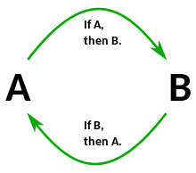
10. Circular Argument (Circular Reasoning)
In a circular argument, the premise usually just restates the conclusion rather than supporting it

Slide 22
An example of a strong argument is:
A circular argument looks like this:
Conclusion: We know the earth is round (conclusion) because
Premise: People have known for hundreds of years that it is that shape (premise).
Conclusion: We know the earth is round (conclusion) because
Premise 1: We have images of it from space (premise 1) and
Premise 2: The laws of gravity demonstrate that the earth is round (premise 2).

Slide 23
Some more examples
Using logic is important because it’s important to use logical reasoning!
Maya has lots of friends because she’s popular.
You have to drive under the speed limit because it’s illegal to drive faster than the speed limit.
You need to do your homework because homework is required for this class.

Slide 24

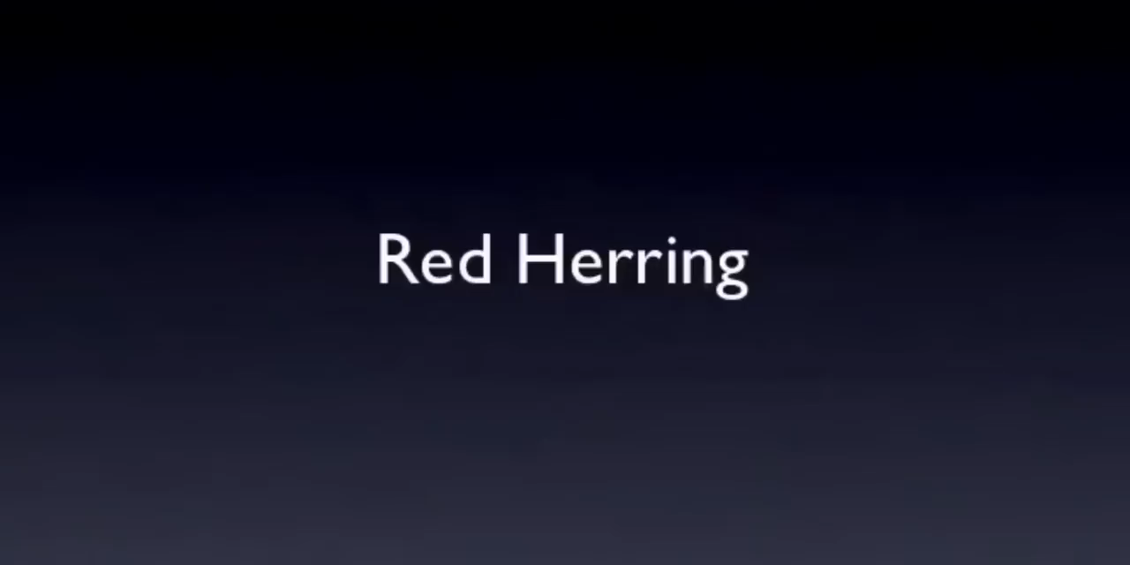
11. Red Herring
The red herring is a diversionary tactic that avoids an argument rather than addressing it. It sometimes creates another irrelevant “argument” to distract the listener from the real issue.

Slide 25
Some more examples
Convincing a parent to lend you the car: “I know you don’t want me to borrow the car, but I was going to pick up coffee for you. Don’t you love coffee?”
Arguing against giving raises: “We can’t raise salaries, but we still provide great benefits for our employees.”
Defending one's inaction in regard to environmental protection:
Citizen: “What policies can you implement to help protect the environment?”
Politician: “Protecting the environment is very important so we can create a livable planet for our children, and l’ve always promoted policies that support children. Look at what I've done for K-12 education.

Slide 26
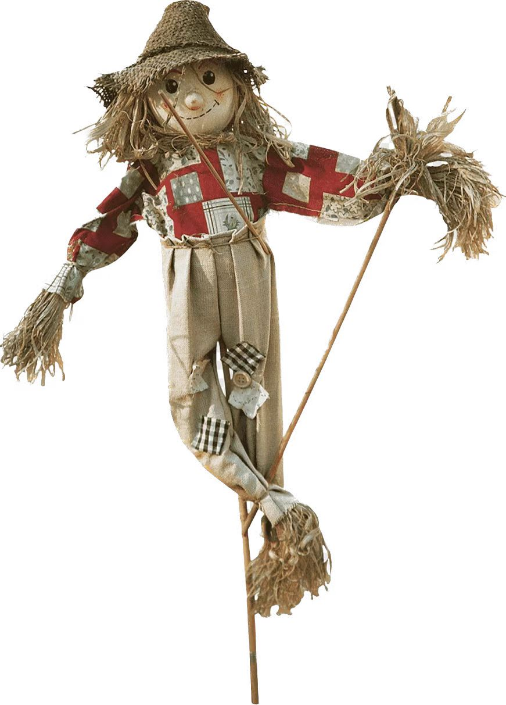
12. Straw Man Fallacy
This fallacy occurs when a person rebuts an argument by misrepresenting it.
The straw man fallacy consists of an oversimplification or outright distortion of opposing views.
e.g.,
A: I like pasta more than pizza.
B: Well, you must hate pizza.

Slide 27
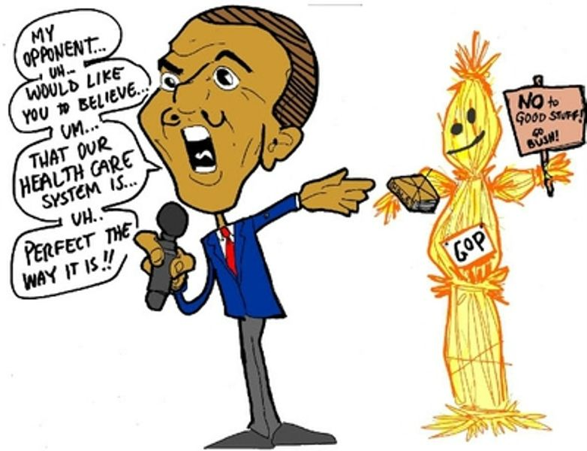
Straw Man Fallacy in Debates
Person 1: I think we should increase benefits for unemployed single mothers during the first year after childbirth because they need sufficient money to provide medical care for their children.
Person 2: So you believe we should give incentives to women to become single mothers and get a free ride from the tax money of hard-working citizens? This is just going to hurt our economy and our society in the long run.

Slide 28
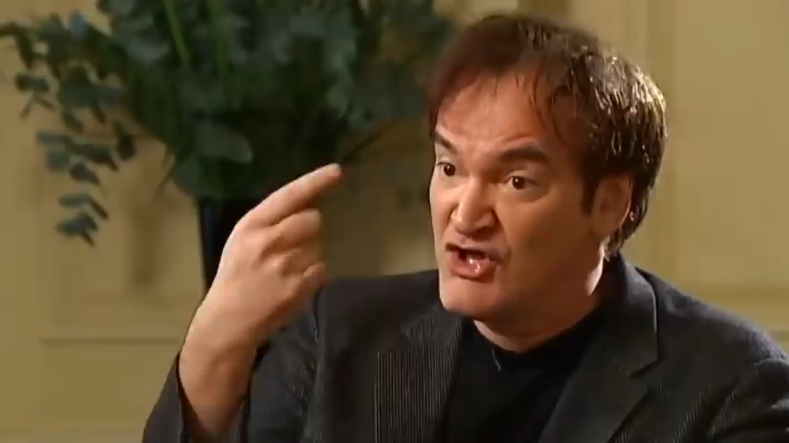

Slide 29
Some more examples
Scenario 1: A teacher says her class needs to spend more time on math tasks. A parent complains, saying the teacher doesn’t care about literacy subjects.
Scenario 2: A parent doesn’t let their daughter go to a party. The daughter responds with “Why do you hate me?”
Scenario 3: A wife asks her husband which pair of pants look better. He says that the second pair make her look slim. She scowls at him, saying he thinks she looks fat in the other pair of pants.

Slide 30
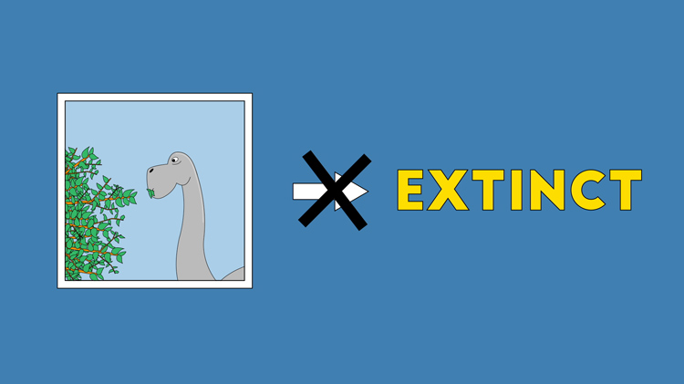
13. False Cause
The false cause fallacy occurs when someone incorrectly identifies the cause of something
Assuming causation based on correlation or coincidence.
e.g., Dinosaurs become extinct because they eat vegetables

Slide 31
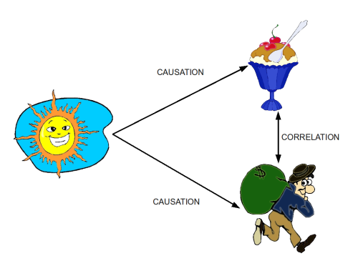
ice-cream sales
house burglaries
Source: Wikimedia Commons

Slide 32
Two most common forms this fallacy
Type 1: Post Hoc Ergo Propter Hoc
It has the structure: X causes Y because Y happened after X.
Type 2: Cum Hoc Ergo Propter Hoc
It has the structure: X causes Y, because X and Y happened at the same time.

Slide 33

Some more examples
Scenario 1: I drank bottled water and now I am sick, so the water must have made me sick.
Post Hoc Ergo Propter Hoc
Scenario 2: Natalia is a very skeptical person. She thinks to herself that if hospitals really made people better, they wouldn’t always be full of sick people.
Cum Hoc Ergo Propter Hoc

Slide 34
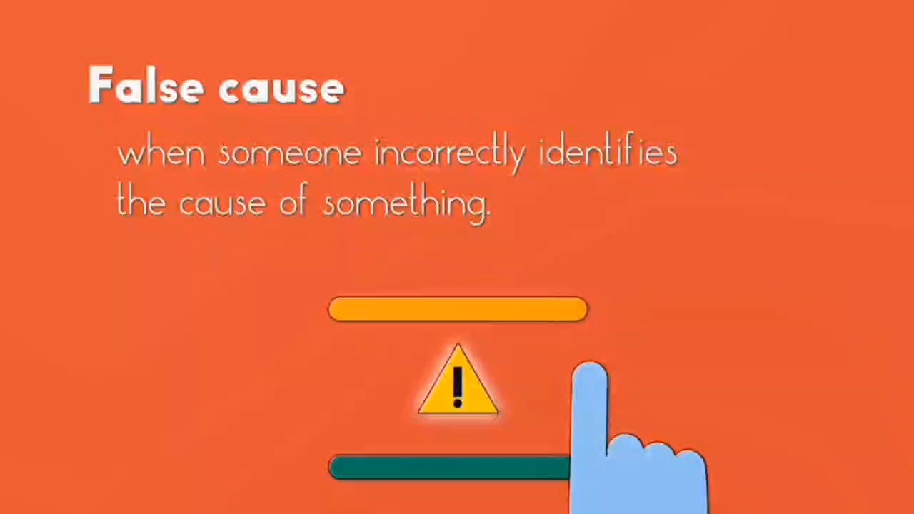

Slide 35
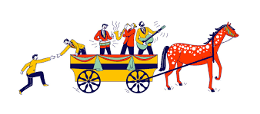
14. The Ad Populum Fallacy: Appealing to the Masses
This is an appeal that presents what most people, or a group of people think, in order to persuade one to think the same way.
Getting on the bandwagon is one such instance of an ad populum appeal (Bandwagon Appeal)

Slide 36
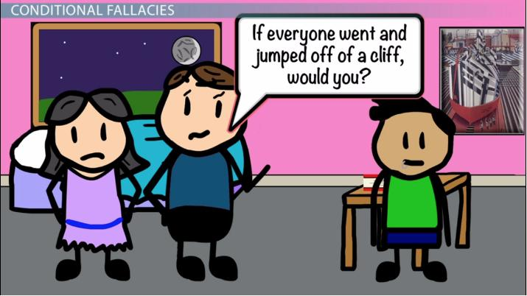
14. The Ad Populum Fallacy: Appealing to the Masses
The ad populum fallacy has the following logical scheme:
The majority asserts that A is true.
Therefore, A is true.

Slide 37
Examples of the ad populum fallacy
The majority of voters are in favor of this law, so it’s a good law.
You have to do it that way because everybody does it that way.
It must be a really good car because so many people have bought one.
Most people believe in life after death, therefore it must exist.
Most people consider the death penalty to have a significant deterrent effect. To suggest otherwise is totally ridiculous.
We’re a leading brand in the market, millions of people say so.
Use lotion B, the favorite of all women.
You must switch to this new Internet company. It’s currently the one with the most users.

Slide 38
To avoid writing a bandwagon argument, follow these tips：
Know that consensus is not proof, and large groups can be wrong!
Do not use group consensus as proof and think that their consensus is wholly accurate or logical.
Do not use evidence that is founded on opinion.
Opinions cannot be proven.
When you look at many people agreeing on something, consider, “Are these people agreeing on a proven fact, or have they been persuaded to have an opinion?”

Slide 39
Task 1. Go through the sentences on your worksheet and identify the logical fallacies if any.
You can’t trust Tom’s opinion on climate change because he’s not a scientist.
There’s no evidence that the lost city of Atlantis doesn’t exist, which is a reason to believe it could have existed.
Either you’re with us or against us.
I really shouldn’t eat this slice of pizza because if I do, I’ll probably lose all control and go off my diet, and then I’ll keep gaining weight and eventually get diabetes.
Millennials are all lazy and entitled because I know one who doesn’t work.

Slide 40
Task 1 Cont.
God exists because the Bible says so, and the Bible is the word of God.
Every time I wear my lucky socks, my team wins. Therefore, my lucky socks make my team win.
Dr. Brown says that this diet pill is the best on the market, so it must be true.
My opponent thinks we should give everyone free cars. Clearly, that’s an unrealistic and unaffordable idea.
If America can be the first country to put a person on the moon, it can also be the first country to put a person on Mars.
It must be a really good car because so many people have bought one.
All of my friends slept through ENG1002, and they all passed. There’s no reason why it won’t be the same for me.
Humans cannot be replaced by AI because humans are irreplaceable.

Slide 41
References
Hacker, D., & Sommers, N. I. (2016). The Bedford handbook. Bedford/St Martin's.
https://owl.purdue.edu/owl/general_writing/academic_writing/logic_in_argumentative_writing/fallacies.html
https://blog.hubspot.com/marketing/common-logical-fallacies
https://fallacies.escepticos.es/wp-content/uploads/2020/09/02eng.gif
https://helpfulprofessor.com/begging-the-question-fallacy-examples/
https://www.grammarly.com/blog/appeal-to-ignorance-fallacy/

